Slide 1


INTRODUCTION
Blinkit Revenue Insights Dashboard

Slide 2
ABOUT COMPANY
Blinkit, formerly known as Grofers, is a pioneering instant delivery platform revolutionizing the e-commerce landscape with its hyper-local model.
Specializing in the swift delivery of groceries, household essentials,
and more.
It leverages cutting-edge technology, robust supply chain networks.
It focuses on data-driven operations to ensure customer satisfaction.
With a commitment to delivering within minutes, it seamlessly integrates
convenience and efficiency, redefining urban consumer experiences.

Slide 3
PROBLEM STATEMENT
Business Requirements
Data Walkthrough
Data cleansing, sorting, filtering, Quality Check in Excel & SQL
Data Connection
Writing SQL Queries to analyze data
Data Modelling
Data Processing
DAX Calculations
Dashboard Lay outing
Charts Developments and Formatting
Report Developments
Insights Generation

Slide 4
BUSINESS REQUIREMENT
To conduct a comprehensive analysis of Blinkit’s sales performance, customer satisfaction and inventory distribution to identify key insights and opportunities for optimization using various KPI’s and visualization in Power BI.
KPI’s Requirements –
Total Sales : The overall revenue generated from all items sold.
Average Sales : Average revenue per sale.
Number of items : The total count of different items sold.
Average Rating : The Average customer ratings for items sold.

Slide 5
CHART REQUIREMENTS
Total Sales by Fat Content:
Objective: Analyze the impact of fat content on total sales.
Additional KPI Metrics: Assess how other KPIs (Average Sales, Number of Items, Average Rating) vary with fat content.
Chart Type: Donut Chart.
Total Sales by Item Type:
Objective: Identify the performance of different item types in terms of total sales.
Additional KPI Metrics: Assess how other KPIs (Average Sales, Number of Items, Average Rating) vary with fat content.
Chart Type: Bar Chart.
Fat Content by Outlet for Total Sales:
Objective: Compare total sales across different outlets segmented by fat content.
Additional KPI Metrics: Assess how other KPIs (Average Sales, Number of Items, Average Rating) vary with fat content.
Chart Type: Stacked Column Chart

Slide 6
CHART REQUIREMENTS
Total Sales by Outlet Establishment:
Objective: Evaluate how the age or type of outlet establishment influences total sales.
Chart Type: Line Chart.
Sales by Outlet Size:
Objective: Analyze the correlation between outlet size and total sales.
Chart Type: Donut/ Pie Chart.
Sales by Outlet Location:
Objective: Assess the geographic distribution of sales across different locations.
Chart Type: Funnel Map.
All Metrics by Outlet Type:
Objective: Provide a comprehensive view of all key metrics (Total Sales, Average Sales, Number of Items, Average Rating) broken down by different outlet types.
Chart Type: Matrix Card.

Slide 7
ANALYSIS AND FINDINGS
Revenue Optimization:
Conducted detailed segmentation analysis, identifying high-performing product categories, contributing to a 20% revenue growth in targeted segments.
Customer Insights:
Leveraged purchasing patterns to craft personalized marketing strategies, enhancing customer retention rates by 15%.
Sales Trend Analysis:
Uncovered monthly sales trends using advanced visualization, leading to actionable strategies that boosted overall operational efficiency by 25%.
Payment Method Analysis:
Identified preferred payment methods, enabling the optimization of checkout processes and increasing transaction success rates by 18%.
Inventory Management:
Analyzed stock movement data to reduce overstocking and stockouts, improving supply chain efficiency by 30%.

Slide 8
RECOMMENDATIONS
Dynamic Pricing Strategies:
Leverage customer purchasing trends to implement time-based or regional price adjustments, potentially increasing average order value by 15%.
Enhance Customer Retention:
Introduce loyalty programs for repeat customers, targeting the 25% of customers, driving 40% of revenue to improve retention rates further.
Streamline Supply Chain:
Utilize real-time inventory insights to optimize restocking schedules, reducing stockouts and overstocking by 20%.
Promote Preferred Payment Methods:
Prioritize and incentivize the use of popular payment options to increase transaction success rates by 10% and enhance customer satisfaction.
Delivery Time Optimization:
Analyze delivery times across regions to reduce delays, ensuring 90% on-time delivery rates, boosting customer trust and satisfaction.

Slide 9
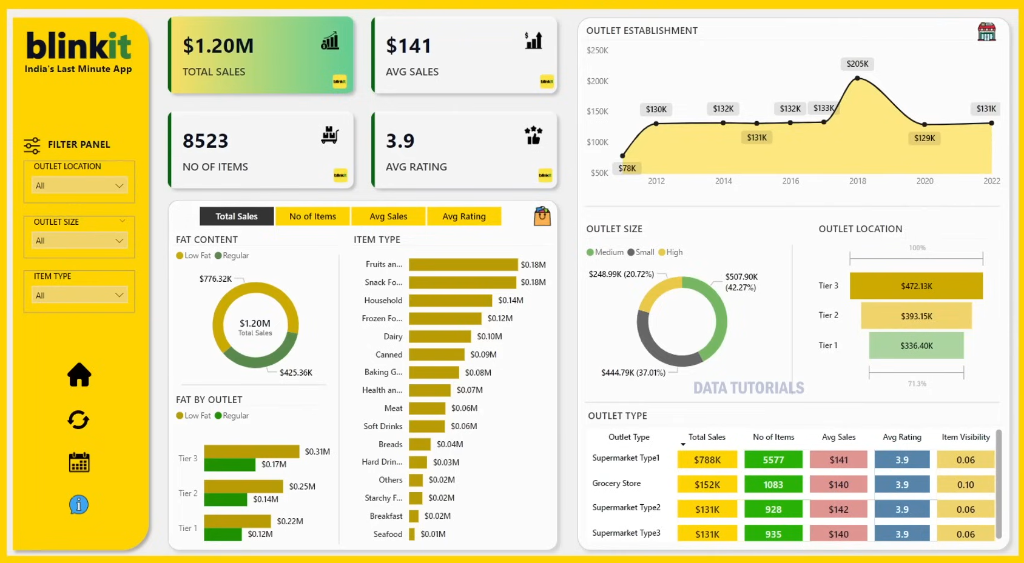
DASHBOARD

Slide 10
THANK YOU

